Slide 1

Research methods and project management individual oral presentation research theme: IT System acceptance in UK universities.

Slide 2
Design/Implementation - theoretical understanding
This research examines the development of “IT systems acceptance in UK universities”, with a specific emphasis on the transition regarding self-service approaches for students and staff.
It explores the use of generative AI technologies, such as chatbots, to enhance the functionality of these systems.
RESEARCH PHILOSOPHY: Pragmatism
RESEARCH METHODOLOGY USED: Mixed method
(both qualitative and quantitative)
RESEARCH APPROACH: Deductive(top-down)
CASE STUDY: Collective
TRIANGULATION: Methodological triangulation
(Qualitative and Quantitative)

Slide 3
METHODS USED
QUANTITATIVE DATA
QUALITATIVE DATA
SECONDARY DATA
SURVEY
INTERVIEW
OPEN DATA
RESEARCH APPROACH: DEDUCTIVE (Top-Down):
Theories/hypothesis Analyse data Hypotheses Supported or not
(specific level of focus) (Analysis) (specific level of focus)

Slide 4
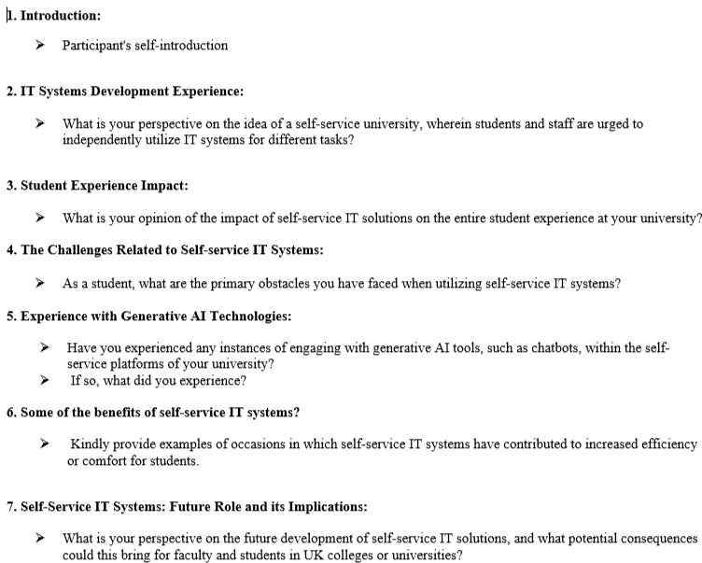
Design/Implementation of Research Methods – Practical Experience
.
The participants are chosen from my module, with a total of 2 participants for the Interview.
INTERVIEW:
Formulated research theme questions for conducting interviews.
Data collection: This data has been collected by using of Microsoft Teams meeting.
The transcripts of the sessions have been applied to analyze data.
For Interview Analysis methods used Qualitative data (Thematic Analysis)

Slide 5
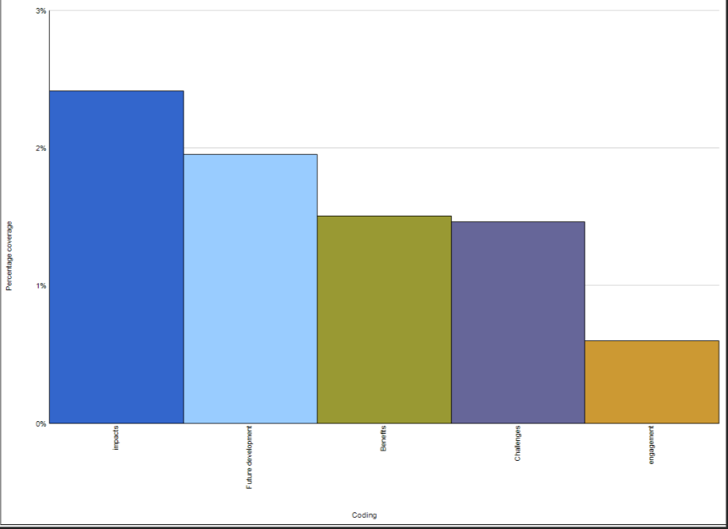
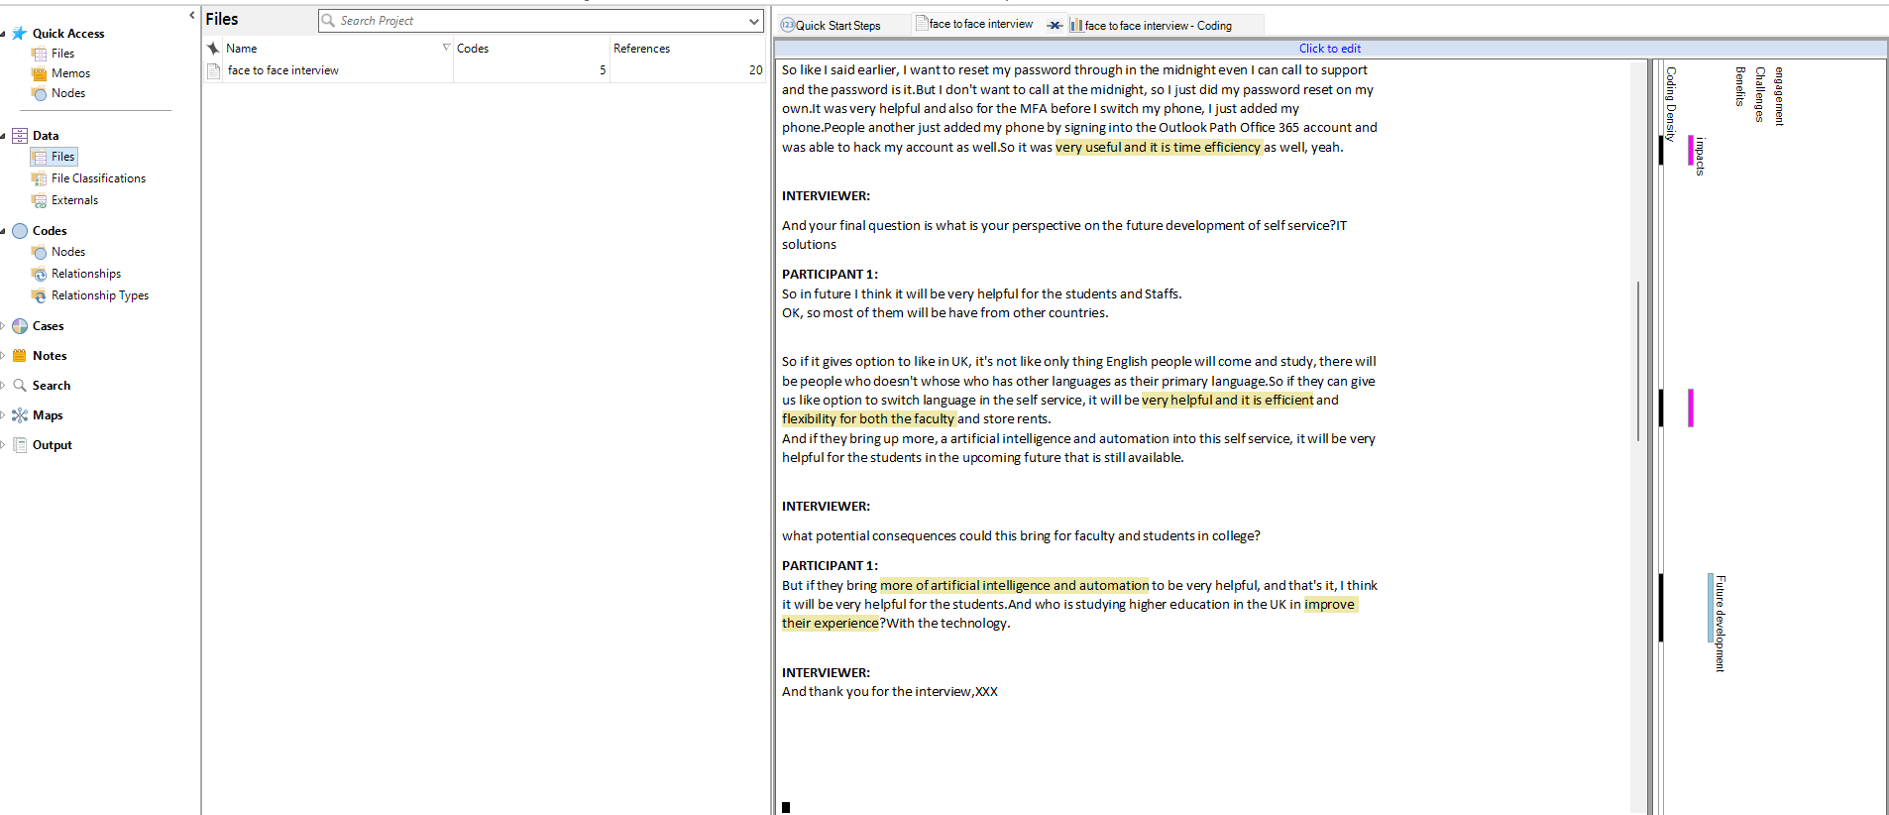
The methodology I have used for an interview is qualitative analysis.
Conducted interviews and obtained the transcripted via Meetings.
Uploaded the transcript data into the Nvivo software to do thematic analysis.
Implemented nodes to encode the data.
Given the research question, I have processed the gathered
data using coding techniques.

Slide 6
Application and Interpretation of Qualitative and Quantitative Data Analysis– Theoretical Understanding
.
QUALITATIVE DATA ANALYSIS
Encompasses non-numerical information, frequently in the form of text or visuals.
Employs techniques that include interviews, and open-ended surveys.
Seeks to thoroughly investigate the perspectives and encounters of participants.
Analyze written or visual data extensively to uncover common themes.
Thematic Analysis using software such as NVivo
RESEARCH DESIGN:
EXPLANATORY SEQUENTIAL DESIGN:
QUANTITATIVE DATA ANALYSIS
Contains quantitative information, typically gathered by created surveys.
Focus on the statistical analysis of information.
Usually includes closed-ended questions with set topics for answers.
Software for statistics: SPSS, SAS, Excel, and R are some examples.
Uses statistical tests to look for patterns and connections in the data.
Follow up with
Interpretation
Quantitative data collection
and Analysis
Qualitative data collection
and Analysis

Slide 7
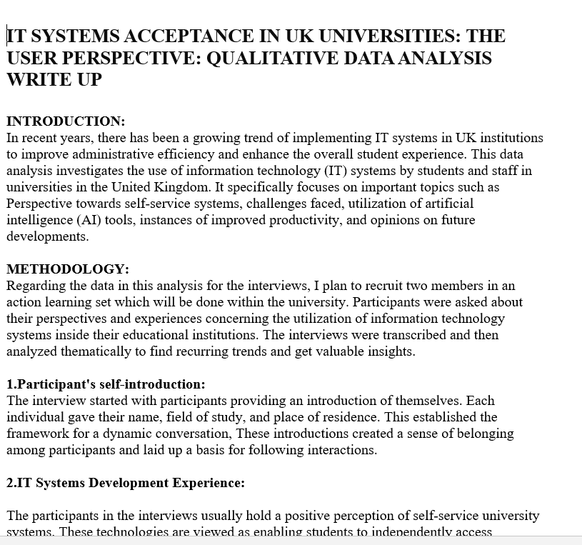
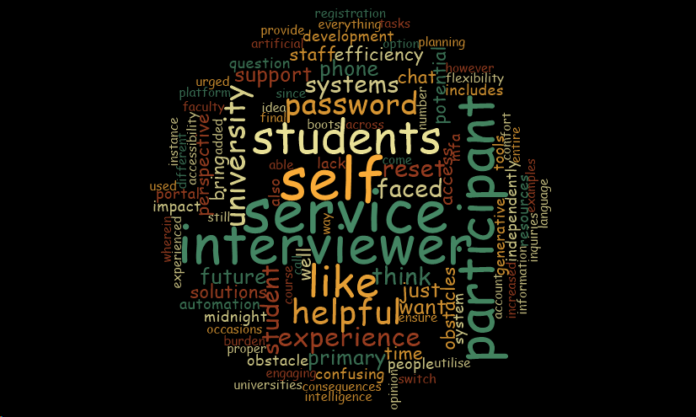
Application and Interpretation of Qualitative and Quantitative Data Analysis– PRACTICAL Understanding
Employed to graphically represent the key topics and commonly utilized words in the analyzed content.
Words are ranked according to the frequency of their occurrence, with words that are bigger representing higher frequency.
Qualitative analysis write-up has been completed.
Word cloud

Slide 8
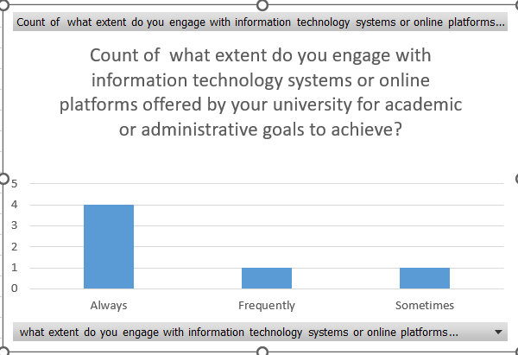
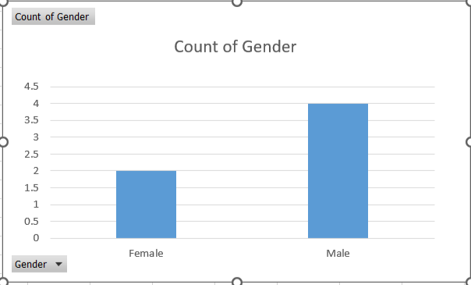

Participants are chosen from my module, with a total of 6 participants for the Survey.
SURVEY:
The Survey form has been created using Microsoft Forms.
Shared forms for surveys with the participants via email or the Teams platform.
Responses were collected.
For survey analysis- quantitative data.
Analysis:
This analysis presents the frequency distribution of responses, revealing that 4 respondents always interact with IT systems or online resources, 1 respondent does so frequently, and 1 respondent does so sometimes.
Count of gender analysis was made there are 4 Males and 2 Female

Slide 9
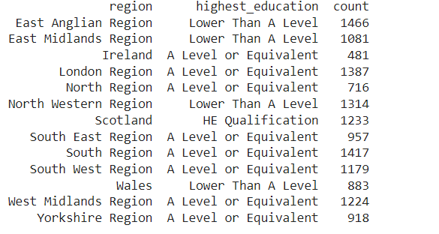
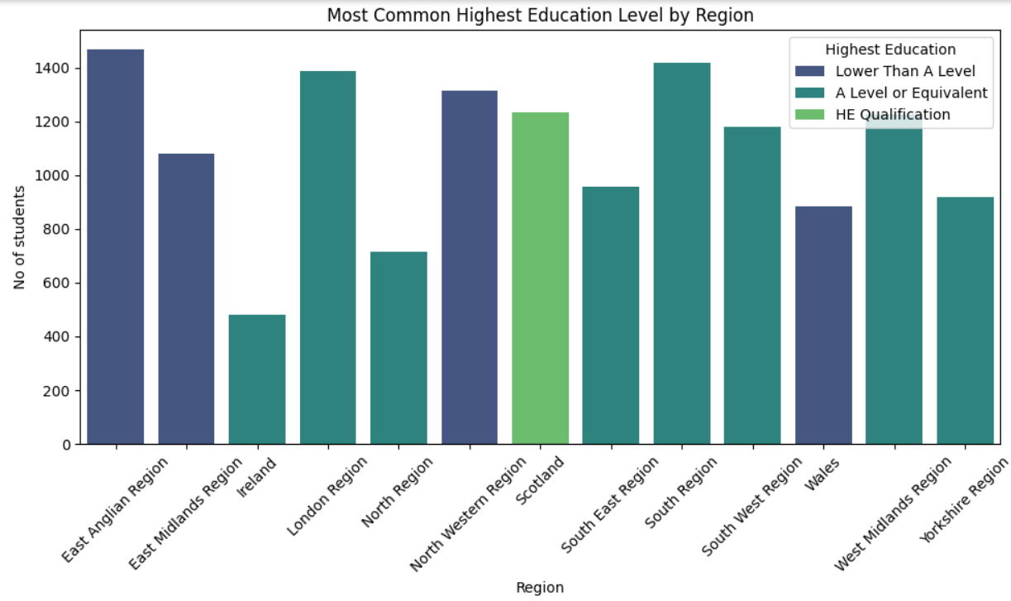
Analysis for open dataset:
Link to the open dataset:
https://figshare.com/articles/dataset/OULAD_Open_University_Learning_Analytics_Dataset/5081998/1
Importing the dataset
Cleaning and preprocessing the data
In this figure, the X-axis has a region and the Y-axis is the count of the students,
Finding who has the most common highest education level by Region.
In the Eastern Anglian Region, the predominant highest level of education is "Lower Than A The level," with a total of 1466 students.
However, in Ireland, the most common highest degree of education is "A Levels or Equivalent," with a total of 481 students.

Slide 10
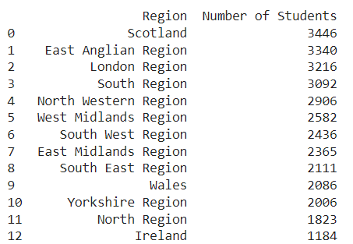
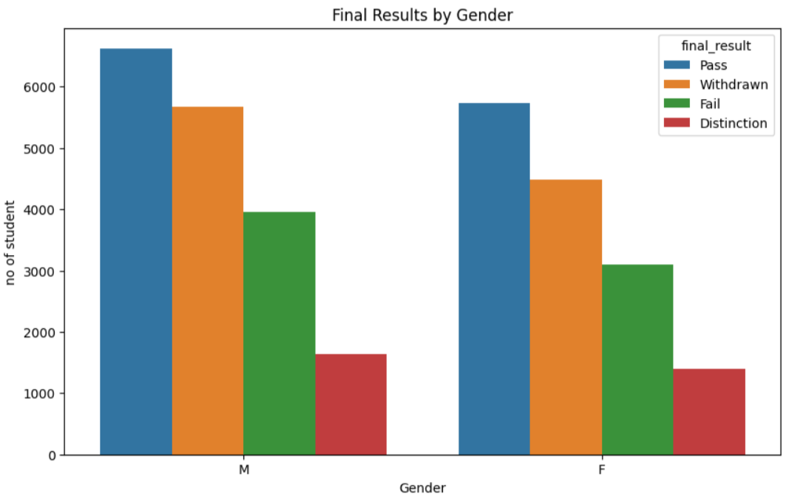
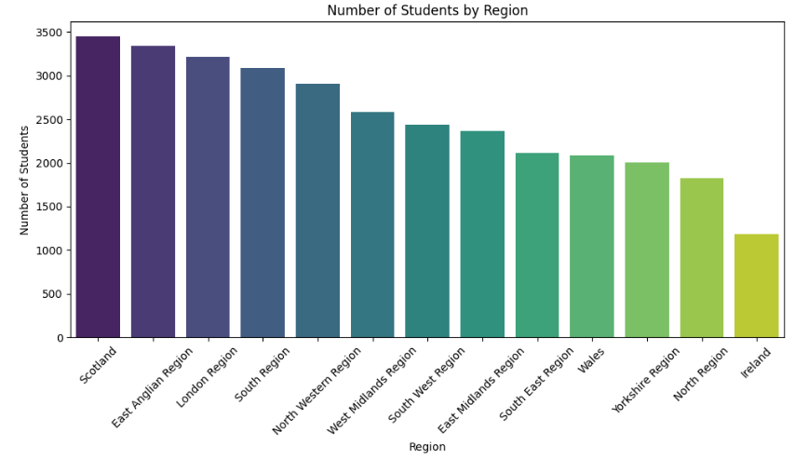
Scotland has the largest number of students, with a total of 3446 students. From the analysis, The number of Male students results are higher compared to females.

Slide 11

CONSIDERATION AND APPLICATION OF AN ETHICAL AND PROFESSIONAL APPROACH
The participant information sheet as well as consent form were given to ensure an understanding of the research's aim, procedures, and rights.
Privacy and security measures safeguard the privacy of participants’ information.
The data is securely saved in the university's online drive to ensure confidentiality and security.
This guarantees that the privacy, security, and well-being of those participating are given top priority, and persons who do not meet the requirements will be excluded from the research project.
Got approval from an institution review board and staff right before beginning interviews.
Informed participants of their voluntary participation in the research, emphasizing their freedom to join and withdraw at any time without encountering any difficulties.

Slide 12
REFLECTION/ EVALUATION OF YOUR RESEARCH EXPERIENCE AND JOURNEY THROUGH THE MODULE
.
The reflective journals were written by me.
Interviewing people in a qualitative way to study IT systems acceptance in universities.
The problem Faced: Having a lot of different tasks made it hard to find sufficient time to effectively recruit participants.
At first, I felt disappointed and worried about what it entailed for my study.
Despite the challenges I came into, the experience helped me learn more about how to do research and how to deal with concerns.
Acquired a greater knowledge about IT system acceptance in universities.
THANK YOU

